Slide 1

CNS4202 DESIGN AND ANALYSIS OF ALGORITHM
TRAFFIC OPTIMIZATION FROM UPM TO BESUT DURING FESTIVE SEASON
GROUP 4:
AZYAN SYAZWANI BINTI SETIA (215014)
FATIN NASUHA BINTI ZURAIDI (215190)
AYA SOFEA BINTI ROSLI (214973)
SITI NAJMA IZZATY BINTI MUHD ASYRAF (216922)

Slide 2
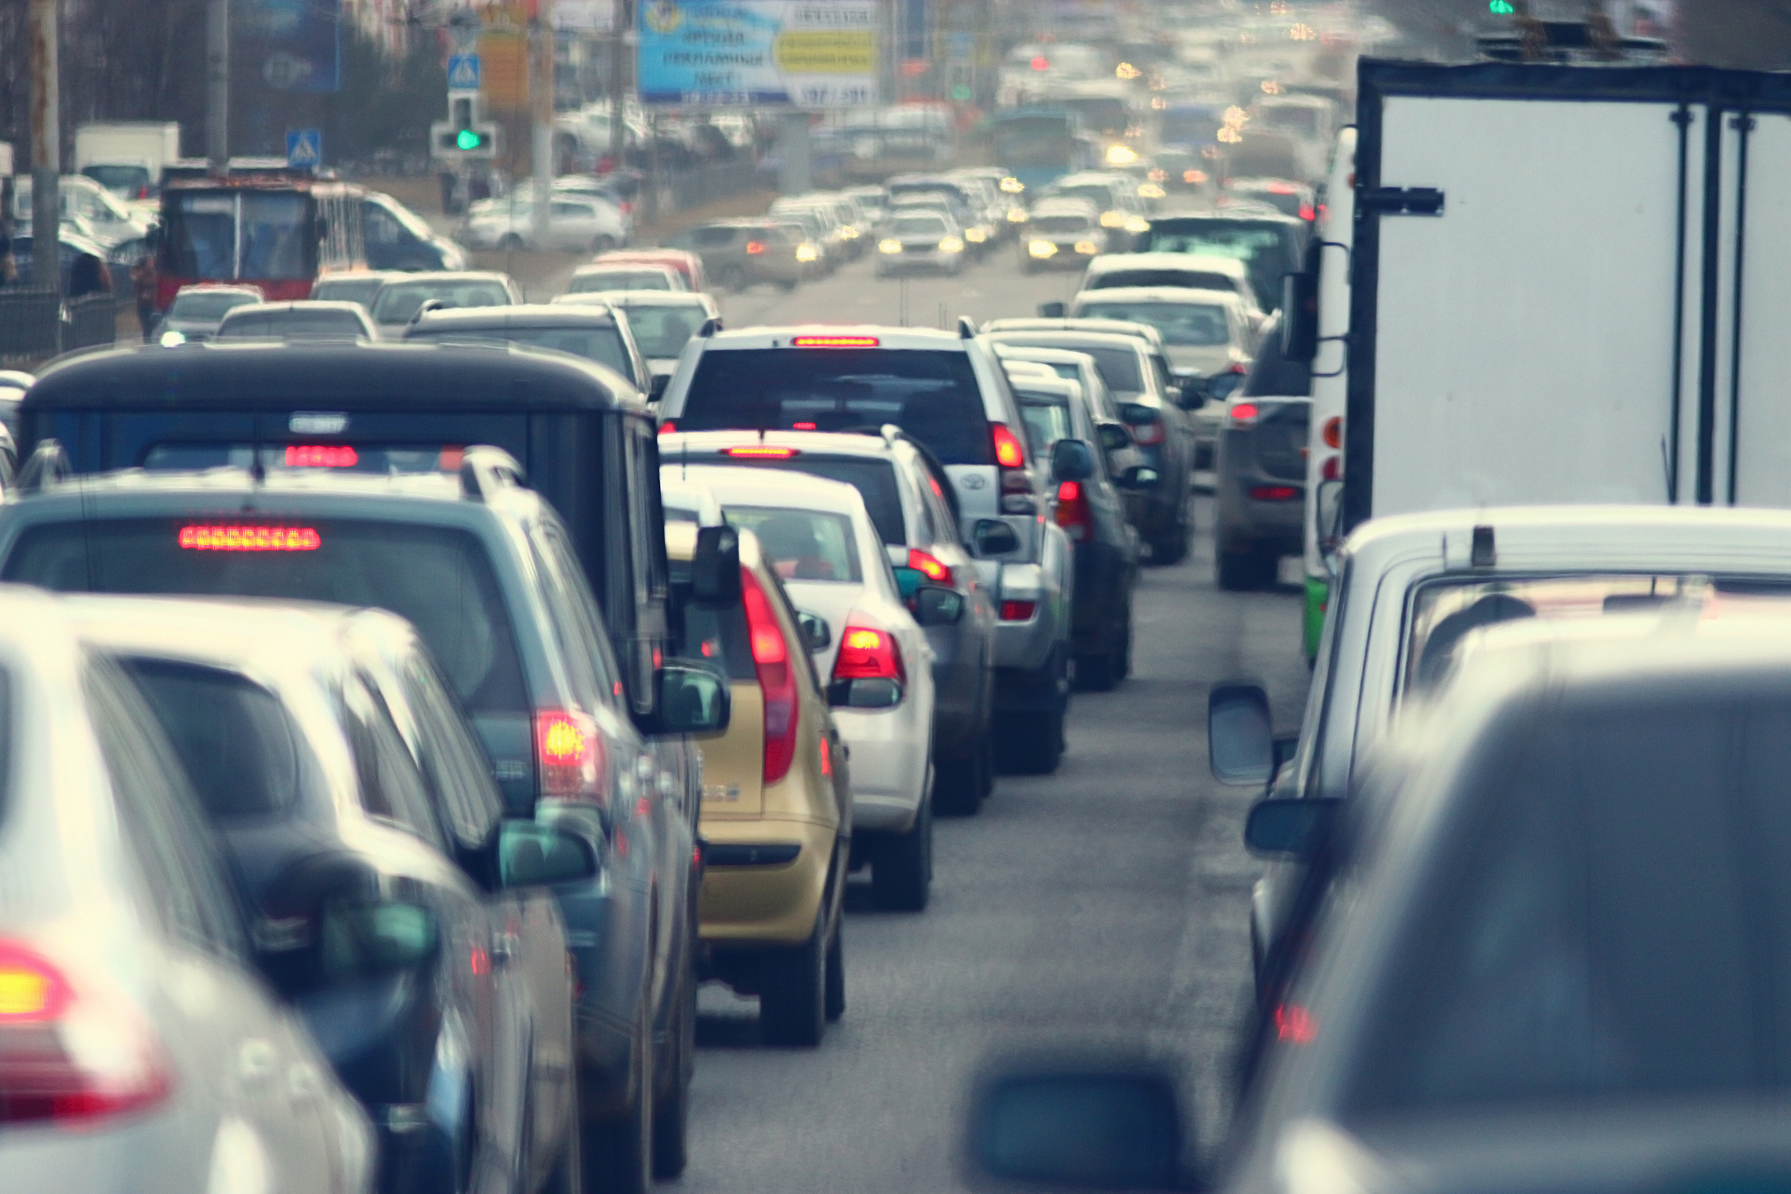
1. Overview of the issue
Introduction
Traveling from UPM to Besut becomes highly challenging during festive seasons (e.g., Hari Raya, Chinese New Year).
The journey involves key expressways: ELITE, LPT1, and LPT2.
Severe congestion is common, especially at major choke points such as Gombak Tol, Karak Highway, Kuantan exit
A typical 7–8 hour trip can exceed 12 hours during peak traffic.
2.Factors contributing to congestion
Massive surge in vehicles heading back to hometowns.
Limited alternative routes between East Coast and central region.
Highway toll bottlenecks (manual lanes & SmartTAG saturation).
Accidents or road closures worsen delays.
3.Impacts
Increased travel time and driver fatigue.
Higher fuel and toll costs.
Delayed arrival for celebrations or important events
Emergency response delays

Slide 3
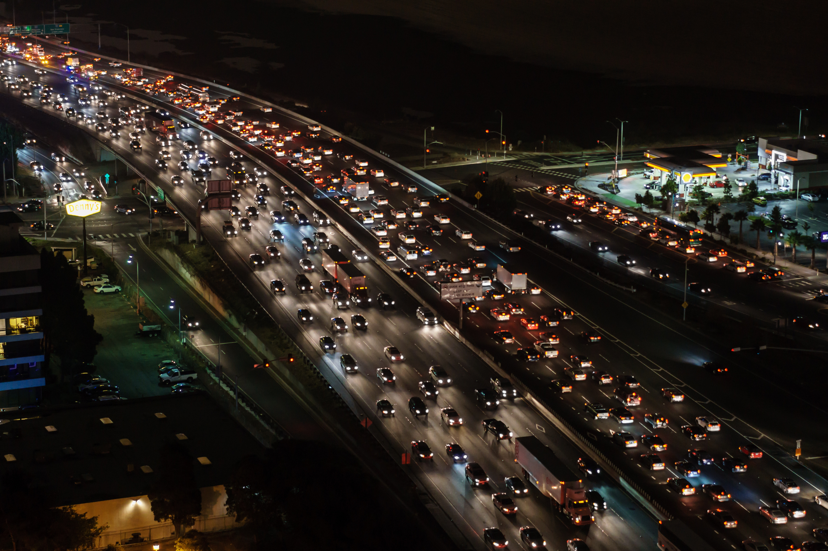
Problem Definition
Objectives
To minimize total travel time and improve traffic flow during peak festive seasons by dynamically optimizing traffic routing
Expected Outcome
Ability to suggest shortest and fastest travel routes based on traffic congestion data.
Reduced travel time, fuel consumption, and driver stress during festive seasons.
Enhance road safety and user experience

Slide 4

Model of the Problem
Approach
Model the journey from UPM to Besut as a directed weighted graph
Nodes: Locations/junctions (e.g., UPM, KL, Karak, Kuantan, Besut)
Edges: Road segments between nodes
Weights: Travel time (minutes) or total cost (RM)
Constraint
Travel is allowed only on defined road segments
Edge weights must be positive (non-negative travel time/cost)
Congestion factors (1.0 – 2.0) vary depending on festive volume
Must start at UPM and end at Besut
Dataset
Dataset includes travel time, toll, and fuel cost between each node
This data is used as edge weights in the graph
Can switch between time-based or cost-based optimization

Slide 5
From | To | Distance (km) | Toll (RM) | Base Time (30 min) | Fuel Cost (RM) | Total Cost (RM)
UPM | KL | 25 | 5.00 | 30 | 5.13 | 10.13
KL | Karak | 60 | 15.00 | 45 | 12.30 | 27.30
Karak | Kuantan | 150 | 25.00 | 120 | 30.70 | 55.75
Kuantan | Kuala Terengganu | 200 | 35.00 | 150 | 41.00 | 76.00
Kuala Terengganu | Besut | 60 | 10.00 | 50 | 8.20 | 16.20
Road Data Table

Slide 6
From | To | Distance (km) | Toll (RM) | Base Time (30 min) | Fuel Cost (RM) | Total Cost (RM)
KL | Alternative 1 | 40 | 8.00 | 140 | 34.85 | 54.85
Alternative 1 | Kuantan | 170 | 20.00 | 140 | 34.85 | 54.85
Karak | Alternative 2 | 80 | 12.00 | 70 | 16.40 | 28.40
Alternative 2 | Kuala Terengganu | 220 | 30.00 | 180 | 45.10 | 75.10
Kuantan | Coastal Route | 180 | 25.00 | 160 | 36.90 | 61.90
Coastal Route | Besut | 70 | 15.00 | 60 | 14.35 | 29.35
Road Data Table (cont)

Slide 7
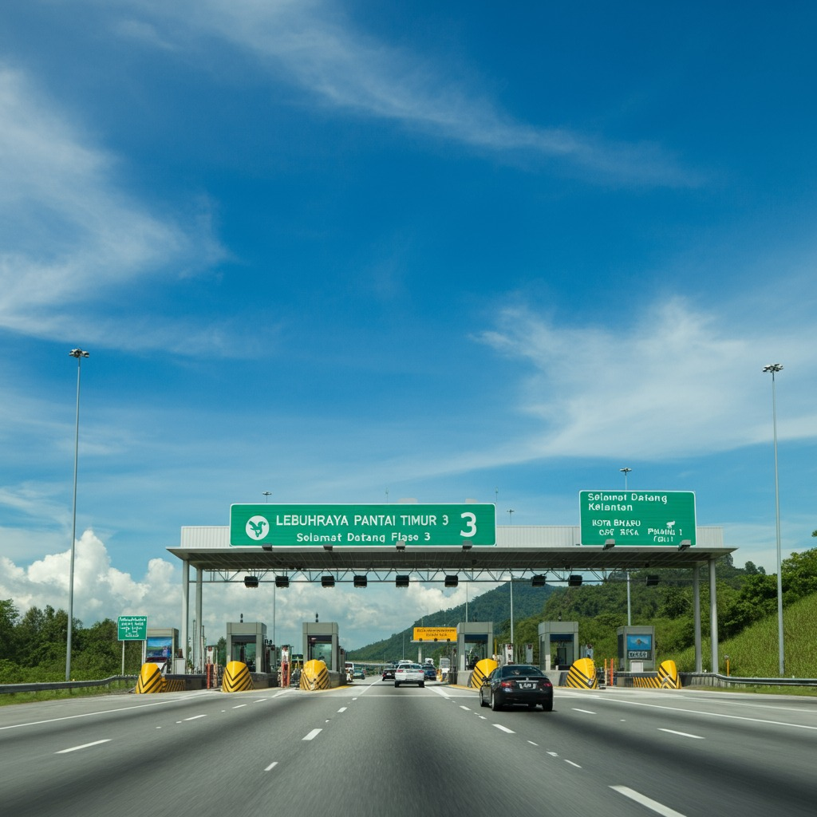
Chosen Algorithm
A* Algorithm
A* is a graph traversal and pathfinding algorithm that is used in many fields of computer science due to its completeness, optimality, and optimal efficiency.
Djikstra Algorithm
Dijkstra's algorithm finds the shortest path from one vertex to all other vertices. Single-source means that one vertex is chosen to be the start, and the algorithm will find the shortest path from that vertex to all other vertices.

Slide 8
Algorithm Comparison
Aspect | Dijkstra’s | A*
Traffic Awareness | Not aware of congestion from UPM-Besut | Considers real-time festive congestion
Search Direction | Explores all possible routes | Focused toward destination
Speed | Slower | Faster
Real-time Use | Limited | Suitable for current highway conditions
Congestion Handling | For static path simulation | For live traffic-based route optimization
Project Use | Cannot adapt to traffic spikes | Avoids congested routes

Slide 9
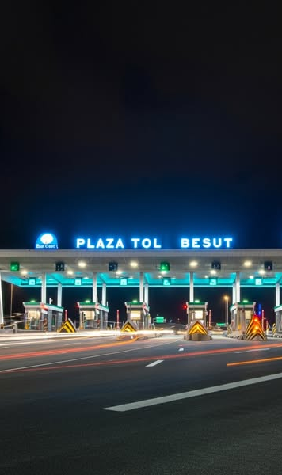
Designing the Algorithm
This project aims to optimize travel from Universiti Putra Malaysia (UPM) to Besut during high-congestion periods, especially festive seasons.
Two pathfinding algorithms are compared:
Dijkstra’s Algorithm – Computes the shortest path using static travel times or distances.
A* Algorithm – Determines the fastest path by factoring in real-time traffic and delays.
The route network (including LPT and alternative roads) is modeled as a weighted graph:
Nodes = Key junctions, toll plazas, and intersections.
Edges = Road segments weighted by distance, average time, or dynamic traffic data.

Slide 10
Dijkstra’s Algorithm Overview
Calculates the shortest path from UPM to Besut using fixed travel times or distances.
Suitable for static routing without considering real-time traffic conditions.
Utilizes a priority queue and a distance table to explore all possible routes.
Identifies the optimal path based on distance or average travel time, making it useful as a baseline method for comparison.

Slide 11
Dijkstra’s Step by Step
Set all node distances to ∞; set UPM (start node) to 0.
Insert UPM into a min-priority queue.
While the queue is not empty:
Extract the node with the smallest tentative distance.
For each neighbor, calculate new travel cost.
If the new cost is shorter, update the distance and reinsert.
Repeat until Besut (destination) is reached.
Backtrack from Besut to UPM to construct the shortest path.

Slide 12
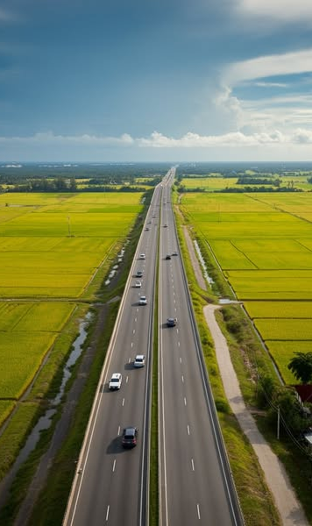
A* Algorithm Overview
Enhances Dijkstra’s Algorithm by using a heuristic to estimate the remaining cost to Besut.
Ideal for real-time, dynamic traffic routing along routes such as LPT or Gua Musang.
Prioritizes the most promising paths, improving routing speed and accuracy during festive traffic conditions.
More effective than static algorithms when handling congestion, delays, or accidents on the road from UPM to Besut.

Slide 13
A* Step by Step
Set all node scores g(n) to ∞; set UPM (start node) g(UPM) = 0.
Calculate f(n) = g(n) + h(n) using a heuristic (e.g., estimated time to Besut).
Insert UPM into a min-priority queue with f(UPM) as priority.
While the queue is not empty:
Remove the node with the lowest f(n).
If it is Besut, stop and reconstruct the path.
For each neighbor:
Calculate tentative g(v) = g(u) + cost(u, v).
If better, update g(v) and recalculate f(v) = g(v) + h(v).
Insert or update the neighbor in the queue.
Backtrack from Besut to UPM to obtain the optimal route considering real-time conditions.

Slide 14
Correctness of Algorithm
Why A* algorithm is chosen
Use of Heuristics for Speed
Single Source to Single Destination Efficiency
A* uses a heuristic function h(n) (e.g., straight-line distance or estimated remaining travel time) to guide the search toward the destination more directly.
A* is designed for finding the most cost-effective path from one start node (UPM) to one target node (Besut)
Reduced Computational Overhead
Scalable for Real-Time Application
A* is efficient enough to support live rerouting when traffic conditions change mid-journey (e.g., from Kajang to Bentong or Kuala Terengganu to Besut).
Because A* prioritizes nodes closer to the goal, it reduces search space and executes faster than Dijkstra in well-structured, large graphs like highway networks.

Slide 15
Correctness of Algorithm
Limitations of Dijkstra's algorithm
Slower Performance
No Heuristic Guidance
Dijkstra explores all possible paths before finding the best one
Dijkstra treats all unexplored nodes equally leads to unnecessary computations.
Unnecessary Exploration
Less Suitable for Real-Time Systems
Dijkstra calculates the shortest path to all reachable nodes, not just to Besut. This adds unnecessary computation, especially when only one path is needed (UPM to Besut).
Dijkstra’s broader search makes it less responsive than A* when rapid recalculation is needed (e.g., roadblock near Jeli)

Slide 16
Performance Analysis
Time Complexity
DIJKSTRA’S ALGORITHM
A* ALGORITHM
with binary min-heap
using heuristic function
O((V+E)logV)
O((V+E)logV)
where:
V is the number of nodes (e.g., tolls, interchanges, rest stops)
E is the number of edges (road segments between them)
where:
V is the number of nodes (e.g., tolls, interchanges, rest stops)
E is the number of edges (road segments between them)
explores all reachable nodes from the source, regardless of destination, resulting in potentially excessive computation
A* explores fewer nodes due to heuristic guidance, making it faster in practice for single-destination tasks.
explores many unnecessary nodes, especially in a large road network like Peninsular Malaysia, where only the path to Besut is needed
Notes:
Comparison in Project Context
In this LPT project, where heuristics are hard to define accurately, A* would likely explore nearly as many nodes as Dijkstra, offering no substantial time-saving.
Dijkstra’s consistent performance makes it more predictable and reliable under real-time conditions.

Slide 17
Performance Analysis
Space Complexity
DIJKSTRA’S ALGORITHM
A* ALGORITHM
O(V)
O(V)
It stores:
Distance for all nodes
a priority queue
previous-node tracking for patch reconstruction
needs to store:
Distance for all nodes
a priority queue
previous-node tracking for patch reconstruction
heuristic values (f(n) = g(n) + h(n)).

Slide 18
Performance Analysis
Scalability
DIJKSTRA’S ALGORITHM
A* ALGORITHM
Scales well for all-pairs or multi-destination routing.
Not efficient for single-source to single-target in large graphs.
May explore unrelated paths (e.g., towards Johor or Perak), increasing processing time.
Designed for single-source to single-target scenarios.
Scales better in large networks when a suitable heuristic is used.
In this project, a heuristic like straight-line distance to Besut is admissible and consistent, ensuring A*’s efficiency.

Slide 19
Performance Analysis
Comparison in Project Context
Criteria | Dijkstra’s Algorithm | A* Algorithm
Routing Objective | Calculates paths to all nodes | calculates path to a single goal node (Besut)
Traffic Environment | Does not prioritize goal-related paths | Uses heuristic to focus on routes toward Besut
Festive Travel Suitability | slower due to full-map exploration | efficient, fast, and scalable for congested holiday routes
Notes:
In the context of the LPT traffic congestion problem, Dijkstra’s Algorithm offers consistent performance, predictable scaling, and simpler integration with dynamic traffic data. A*'s performance benefits cannot be fully realized without a robust heuristic, making Dijkstra the more practical and scalable choice for this system.

Slide 20
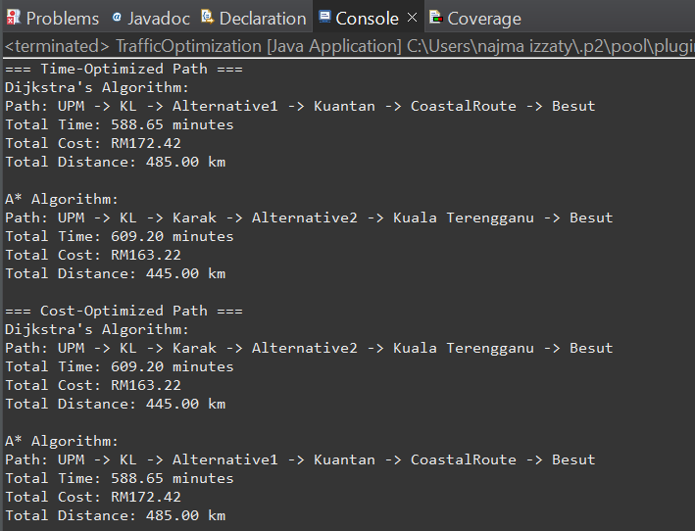
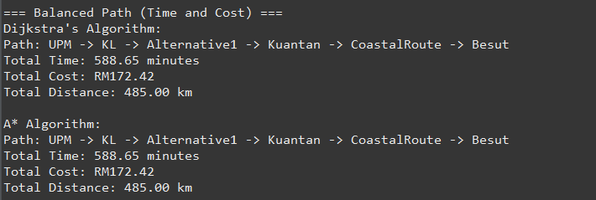
RESULT
Example outputs for the algorithms

Slide 21
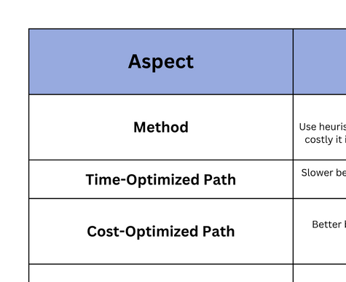
RESULT

Slide 22
ANALYSIS
In comparing the A* Algorithm and Dijkstra’s Algorithm based on output, we chose A* Algorithm as the better option. There are several reasons why A* Algorithm. The A* algorithm uses a heuristic approach, meaning it attempts to “guess” the best direction whereas Dijkstra’s algorithm relies purely on known costs (f(n) = g(n)) and systematically explores all possible paths.
For the time-optimized path, Dijkstra’s algorithm proved to be better because it explored all routes and found a faster path, whereas A* was misled by its time-based heuristic (smart guess), resulting in a slightly longer route.
In the cost-optimized path, A* performed better by finding a faster route, even if it incurred slightly higher costs. This suggests that the time saved using A* was more valuable than the extra cost, making it a more efficient choice when both speed and cost are important considerations.
However, when it came to the balanced path where both time and cost were weighted equally and A* performed better. Its ability to integrate both time and cost into the heuristic allowed it to avoid unnecessary path and reach a path that balanced both metrics effectively

Slide 23
CONCLUSION
In conclusion, both A* and Dijkstra’s algorithms have their strengths depending on the optimization goal. Dijkstra consistently provides the most accurate and reliable results for both time and cost because it explores all possible paths. However, it is slower and less efficient, especially in large networks. A*, on the other hand, offers faster performance and greater efficiency by using heuristics to guide the search.

Slide 24
Thank you

